Slide 1

white hackers
Выполнил: Цыпышев тимофей ИУ5-11б

Slide 2


hackers - who are they?
Scammers or programmers?

Slide 3
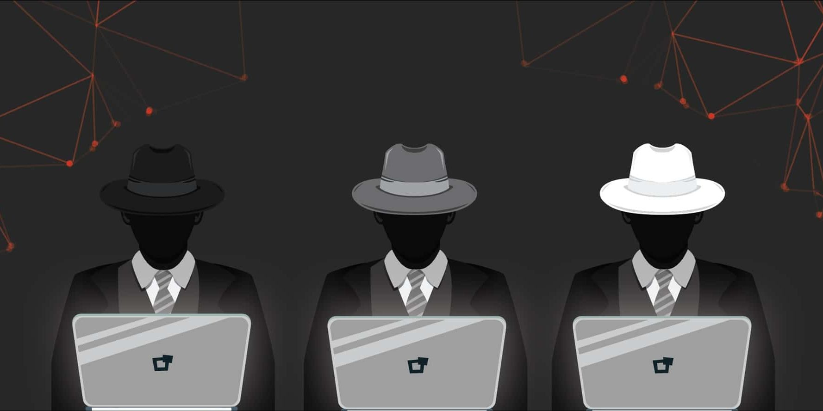
What types of hackers exist and what do they do?
White hats («Белые шляпы») – good mans
Gray hats («Серые шляпы») – bad mans
Black hats («Черные шляпы») – very bad mans

Slide 4

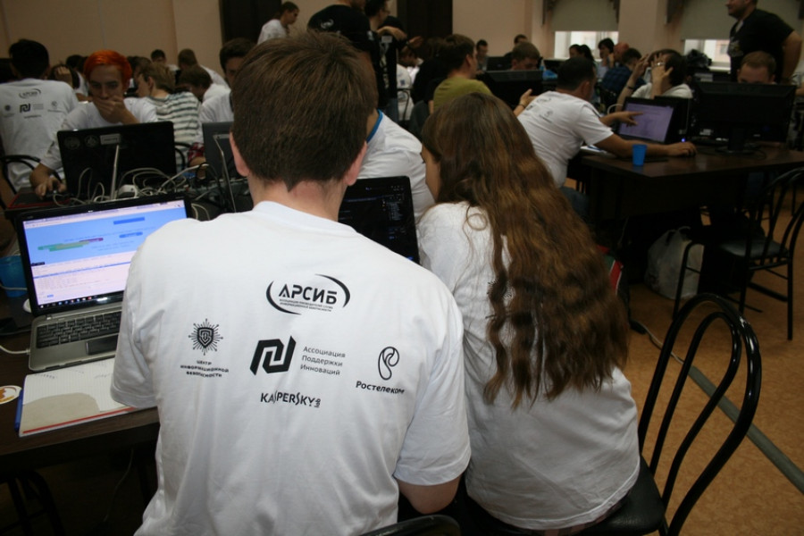
TOP 5 Reasons to Become a White Hacker!!!
Good payment
Great demand
Freedom of movement
A large selection of specialties

Slide 5
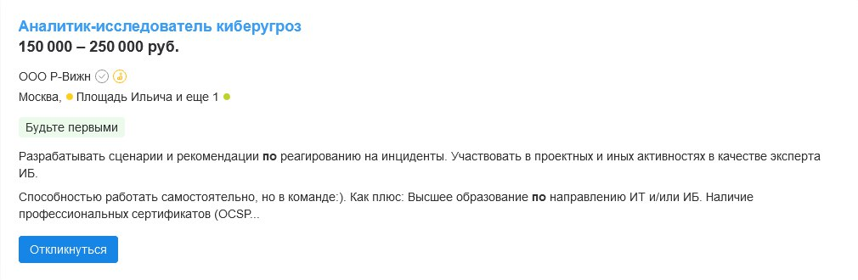
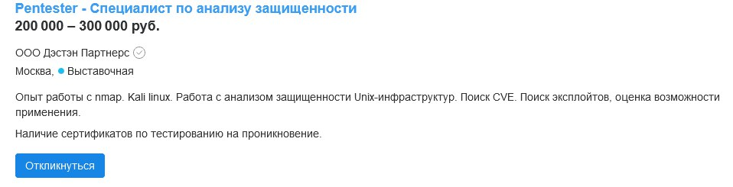
Good payment

Slide 6

Questions???

Slide 7

thanks for watching

